Slide 1

DEPARTMENT OF COMPUTER SCIENCE AND ENGINEERING
Project name : Smart Water System
Team name : Proj_22478_Team_2
Team members :
Pokala Deepika(113321104075)
Rekha RD(113321104081)
Sahana S(113321104082)
Samyuktha J(113321104083)

Slide 2
PROBLEM DEFINITION:
The project involves implementing IoT sensors to monitor water consumption in public places such as parks and gardens. The objective is to promote water conservation by making real-time water consumption data publicly available.
This project includes defining objectives,designing IoT sensor system developing the data sharing platform and integrating them using IoT technology and python.

Slide 3
HARDWARE COMPONENTS:
WATER FLOW SENSOR:
It monitor the amount of water being supplied and used , the rate of flow of water has to be measured.
TURBIDITY SENSOR :
It is used to measure the clarity and transparency of the water
LIQUID Ph SENSOR:
Liquid pH Sensor is used to keep the check on the pH level of the water
TDS SENSOR :
used to measure the total dissolved solids in the water, thus it will keep check on the dissolved salts and other particles in the scale of ppm.
RELAY MODULE:
An electromagnet switch, which helpful for automatically switching off the water pump.
MICRO CONTROLLER:
CPU of this system, It controls and commands all the Peripheral devices connected to it.
NODE MCU MODULE:
A WIFI module, that is the part of IoT system, which helps for data communication and synchronisation.

Slide 4
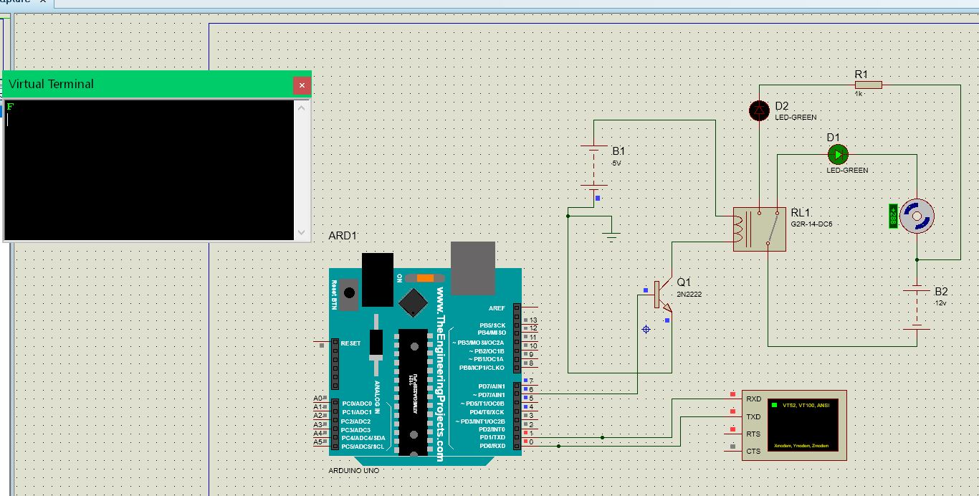
SIMULATION OF HARDWARE:

Slide 5
Python Script Development (On IoT Devices):
1. Set Up the Development Environment
2. Import Required Libraries
3. Initialize Device and Sensors
4. Data Collection
5. Data Processing
6. Data Transmission
7. Error Handling
8. Logging and Debugging
9. Testing
10. Documentation
11. Integration with the Central Server
12. Deployment

Slide 6
WEB TECHNOLOGIES USED:
Front-End: You can use HTML, CSS, and JavaScript for creating a web-based dashboard or user interface. Frameworks like React, Angular, or Vue.js can simplify the development process.
Back-End: You might need a server to handle data processing, user authentication, and other backend functionalities. You can use Node.js, Python, Ruby, or any other server-side technology.
Databases: Use databases (e.g., MySQL, PostgreSQL, MongoDB) to store and retrieve data.
APIs: Create APIs to connect the front-end and back-end. RESTful or GraphQL APIs are common choices.

Slide 7
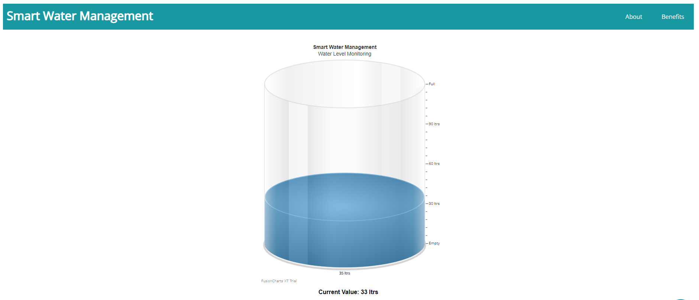
Real-Time Website:
Click here to check my website
Click here to view code on GitHub

Slide 8
CONCLUSION:
With this Project, we can do the analysis of the water quality that is supplied in the cities and due to this we can maintain a report of the quality of water which can be helpful to determine that the supplied water is not harmful for the body.
Also this project helps to save the precious resource such as water and electricity from wasting down on daily basis.

Slide 9
THANK YOU

